Slide 1

INDUSTRIAL MACHINERY
May 2018

Slide 2
Italy
The Perfect Platform for
Machine Industry
May, 2018

Slide 3
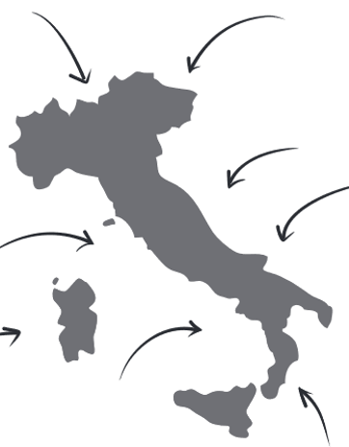
KEY FACTS
3rd largest economy in the Eurozone
Italy is open to Technology and 4.0 manufacturing
Italy has a
large & skilled workforce
Italy has among the lowest labour costs in Western Europe
Competitive location for investment. Cheaper than USA and many Western European competitors

Slide 4
Labour cost
1st
between the European leading economies
Source: Conference Board, International Labor Comparisons (2017 – data 2015)

Slide 5
ITALY IS BACK
Economic Outlook
GDP growth of 1.5% in 2017 is forecast for 1.4% for 2018
Unemployment rate fell by 0,8% between 2016/2017
Exports increased by 7.5% between August 2016/2017
Investors’ confidence index (2017) grows: +3 than 2016.
Italy ranks 13th in 2016 for FDI attractiveness, +5 than in 2015
Italy is the 8th economy in the world, based on strong export

Slide 6
ITALY IS BACK
The Italian Government is successfully promoting a number of reforms that are revitalizing the Italian economy.
Labour Regulation Reform
The "Jobs Act", i.e. the 2015 labour market reform, is aimed at making the Italian work environment more aligned to the flexibility that is needed in today's economic global landscape with the urgency of a reinforced attractiveness of the country.
The Jobs Act’s key points are:
deregulation of dismissal regime (i.e. indemnity for wrongful dismissal in lieu of the reinstatement)
deregulation of fixed-term contracts
significant tax/social security contribution breaks for employers that offer permanent job contracts
promotion of firm-level collective bargaining
job seekers re-allocation by improving private and public labour market institutions
New incentives for hiring young workers have been introduced since 2017

Slide 7
ITALY IS BACK
Corporate Taxation Reform
In the last years the Italian Parliament approved new legislation, including tax incentives, specifically aimed at making Italy an attractive location for investment in manufacturing and R&D.
Among those specific tax incentives, the following are particularly relevant:
Patent box
  a 5 year-elective regime will grant a partial tax exemption on income derived from qualifying intangible assets (patents, know-how, trademarks) as long as the Italian company performs R&D activities
New R&D tax credit
  enhanced for 2015-2019, with the elimination of any access limitation based on turnover and a doubled cap amount (from 2.5M to 5M euro per year)
Tax credits/incentives for the purchase of machinery & industrial equipment
Full deductibility from the IRAP (regional tax) of labour cost for employees hired on a permanent basis

Slide 8
ITALY IS BACK
Corporate Taxation Reform
Other tax incentives are:
The “Destination Italy” Decree
created a specific and dedicated desk of the Revenue Agency (Agenzia delle Entrate) in order to help and provide information to foreign investors, and
enhanced the tax ruling procedures, by extending the validity period of the preventive rulings from 3 to 5 years and including also the existence of Italian permanent establishments of foreign companies

Slide 9
Industrial Machinery

Slide 10
COMPETITIVE ADVANTAGES
High ranking of competitiveness of the Trade Performance Index
Excellent positioning of Italian Industrial Machinery in Europe, in terms of GDP, number of employees and companies
Presence of clusters and technological districts
National policy favorable to innovation and modernisation of enterprises (Impresa 4.0)
Presence of top Universities, competitive and skilled workforce
Excellence in R&D and innovation
Competitive labour cost
Strong Points

Slide 11
TRADE PERFORMANCE
The Ranking of competitiveness of the Trade Performance Index (sectors/worldwide)
Sectors | ITALY | GERMANY | CHINA | REP. OF KOREA | JAPAN | FRANCE | UNITED STATES | UNITED KINGDOM
Non-electronic Machinery | 2 | 1 | 3 | 5 | 7 | 16 | 38 | 12
Transport equipment | 2 | 1 | 26 | 6 | 14 | 13 | 48 | 33
Electronic components | 2 | 1 | 50 | 14 | 4 | 32 | 54 | 61
Miscellaneous manufacturing | 2 | 1 | 4 | 25 | 7 | 49 | 61 | 46
IT & Consumer electronics | 44 | 31 | 6 | 9 | 50 | 45 | 48 | 49
Textiles | 2 | 3 | 1 | 8 | 22 | 45 | 56 | 57
Leather products | 1 | 60 | 2 | 87 | 126 | 35 | 108 | 82
Clothing | 1 | 68 | 2 | 86 | 113 | 69 | 114 | 82
Italy is already leader
Source: International Trade Centre UNCTAD/WTO, Trade performance Index figures, (http://tradecompetitivenessmap.intracen.org/TPIC.aspx2016 ; ‘’Average Index’’)

Slide 12
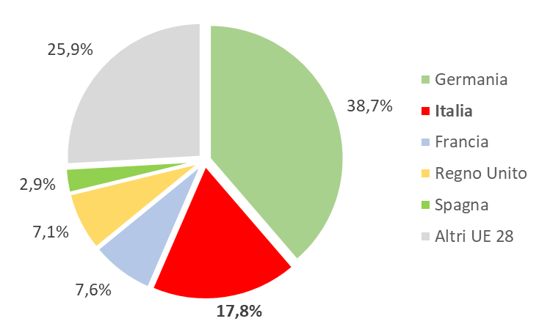
COMPETITIVENESS in EUROPE
Italy ranks second in European Union in terms of GDP
Italy has the highest number of companies, representing about the 25% of total EU companies in the Machinery and Equipment sector
Machinery and equipment:
share of GDP in EU (year 2014)
Country | N° of companies | %
Italia | 23.882 | 25,8%
Germania | 16.135 | 17,4%
Regno Unito | 7.920 | 8,5%
Francia | 5.641 | 6,1%
Spagna | 5.276 | 5,7%
Other EU countries | 33.829 | 36,5%
EU (28 countries) | 92.683 | 100,0%
Eurostat data
Source: Il settore dei beni strumentali nel 2016. Federmacchine. Cinisello Balsamo, luglio 2017

Slide 13








FABBRICA INTELLIGENTE CLUSTER
The Italian Technology Cluster Intelligent Factories – CFI is an association that includes large and medium-small companies, universities and research centres, company associations and other stakeholders active in the advanced manufacturing sector.
Promoting
members
AFIL – Associazione Fabbrica Intelligente Lombardia
www.afil.it
Consortium for innovation and technology transfer of Emilia-Romagna www.aster.it
Marche Manufacturing Cluster Association (MMCA)
www.marche-manufacturing.it
Institute of industrial technologies and automation - National Research Council (ITIA-CNR) www.itia.cnr.it/en
Mechatronic District of Apulia Region
www.distrettomedis.it/en
Polo Mesap - Smart Products and Manufacturing – Piedmont Region www.mesap.it
Technological District for intelligent integrated systems – Liguria Region
www.siitscpa.it
Source: www.fabbricaintelligente.it

Slide 14


OTHER CLUSTERS
Clust-ER Meccatronica e Motoristica in Emilia Romagna, is a community of public and private actors (research centers, companies and training institutes) and operates through working groups representing the value chains: Digital and Advanced Manufacturing; Automation and Robotics; Efficient, sustainable and smart Engines; Advanced Materials in the Manufacturing of Engines and Mechatronics; Avionics and Aerospace; Nautical Affairs; FluidPower.
Polo Meccatronica is a system project, in the field of Industry 4.0, involving key players from the public and private sectors and trade associations. 29 enterprises and 4 start-up, with a total of 218 employees and 68 million of turnover.
Source: www.fabbricaintelligente.it

Slide 15
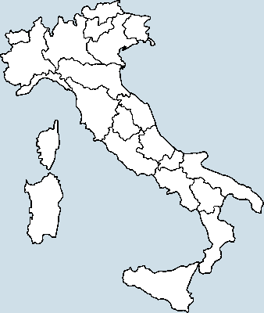
INDUSTRIAL DISTRICTS
DISTRICTS
District white goods Inox Valley
Metadistrict of mechatronics
Heating sector - VenetoClima
Engineering and electronics
Piemonte North East
Cooling systems
Wine machinery
Textile machinery
Machinery District
Recanati-Osimo-Castelfidardo
Lecco Engineering
Iron District
Rubber and plastics
Footwear machinery
Thermic-electronics and components
Machinery District
 | CONEGLIANO
 | VICENZA
 | VERONA
 | IVREA
 | VERCELLI/NOVARA
 | CASALE MONFERRATO
 | CANELLI
 | BIELLA
 | FABRIANO
 | MARCHE
 | LECCO
 | BRESCIA
 | BERGAMO
 | VIGEVANO
 | PORDENONE/UDINE
 | GUASTALLA
Source: http://www.osservatoriodistretti.org/; https://www.istat.it/it/files/2015/10/I-distretti-industriali-2011.pdf, pp. 69ss, 81ss (2015)

Slide 16
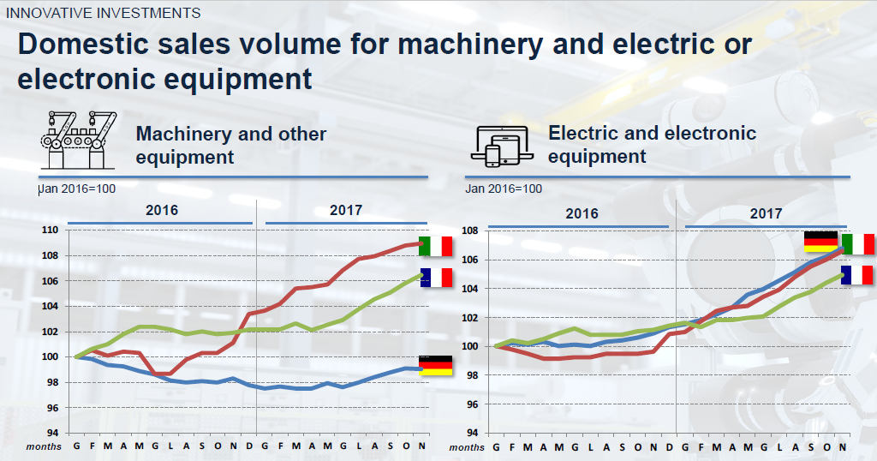
IMPRESA 4.0 NATIONAL PLAN
The National Industry 4.0 Plan (Impresa 4.0), that includes Super-depreciation and New Sabatini Law, is having a positive effect on machinery market.
Source: Italy’s National Plan Impresa 4.0. Results from 2017 – Actions for 2018 . MISE study on Eurostat data

Slide 17



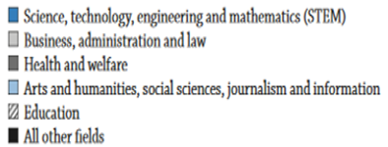
ITALY’S GOT TALENT
Abundant and Skilled Workforce
Italy has some of the world’s best engineering universities. Indeed, engineering is the 2nd highest course for enrolment in the country – 225,619 currently studying an engineering discipline.¹
The Technological Departments of the Italian Universities annually produce a pool of graduates with the knowledge and industry experience to immediately enter the work force.
The engineering sector currently employs around 417,000 people in Italy.³
And much more.
Mainstay
Tertiary-educated 25-64 years old (2016) – Fields of study
Source: ¹Ministry of Education ²AlmaLaurea ³La Repubblica; OECD ILibrary (http://www.oecd-ilibrary.org/education/education-at-a-glance-2017)

Slide 18
TECH RESEARCH IN ITALY
Scientific and tecnological Parks (23)
PST della Sardegna - Porto Conte
POINT POlo INnovazione Tecnologica provincia di Bergamo
Polaris - PST della Sardegna - Pula
Parco Scientifico e Tecnologico della Sicilia - Catania
Consorzio PST Multisettoriale Magna Graecia
Pa.L.Mer
Parco Scientifico biotecnologico San Raffaele
Parco Tecnologico Padano
Parco Scientifico e Tecnologico Galileo
Parco Scientifico e Tecnologico della Sicilia - Palermo
CERFITT
Tecnopolo Tiburtino
Tecnopolo di Castel Romano
Fondazione Toscana Life Sciences
Parco Scientifico e Tecnologico Kilometro Rosso
Sviluppumbria
3A Parco Tecnologico Agroalimentare dell'Umbria
AREA Science Park
Polo ICT
Environment Park
Bioindustry Park Silvano Fumero S.p.A.
Friuli Innovazione - Centro ricerca e trasferimento tecnologico
VEGA VEnice GAteway for Science and Technology
Tech Districts (17)
Distretto H-BIO Puglia
Medis – Distretto meccatronico
Di.T.N.E. - Distretto Tecnologico Nazionale sull'Energia
ComoNext
Distretto Agro-alimentare Regionale D.A.Re. Scarl
DHITECH Scarl - Distretto TEcnologico High Tech
Tecnopolo di Mirandola
Imast S.c.a.r.l.
Atcoroglio
Polo Tecnologico di Pavia
Polo tecnologico di Navacchio
Sardegna DistrICT - DT Biomedicina-Tecnologie Salute
Sardegna DistrICT - DT Tecnologie e Comunicazioni
DTA - Distretto Tecnologico Aerospaziale
Habitech Distretto Tecnologico Trentino
Fondazione Torino Wireless
Centro di Biomedicina Molecolare (CBM)
Other Centres
Aster
C.R.M.P.A. Centro Ricerca Matematica Pura Applicata
CUSSMAC
Tis Innovation Park
Tecnogranda
Tecnopolis
Source: ITA’s elaboration on web and DITT Atlante tecnologico Italia (http://www.ditt.de/atlas/it/)

Slide 19




UPTODATE, NEW IDEAS…
ENGINEERING UNIVERSITIES
CINECA - INTERUNIVERSITY ASSOCIATION www.cineca.it
SIE – SOC. ITAL. ELETTRONICA www.associazione-sie.it
SIRI – ASS. ITAL. ROBOTICA E AUTOMAZIONE www.robosiri.it
ISTITUTO ITALIANO DI TECNOLOGIA www.iit.it
FACULTY OF
ENGINEERING
Strong Points

Slide 20



…RIGHT DEVELOPMENT
Companies Associations:
ELECTROTECHNICAL/ICT http://anie.it/
www.federmacchine.it
INDUSTRIAL MACHINERY www.machinesitalia.org
NATIONAL FEDERATION OF ASSOCIATIONS OF MANUFACTURERS OF CAPITAL GOODS INTENDED FOR INDUSTRIAL AND HANDICRAFTS MANUFACTURING PROCESSES

Slide 21








FEDERMACCHINE: A FOCUS
NATIONAL FEDERATION OF ASSOCIATIONS OF MANUFACTURERS OF CAPITAL GOODS INTENDED FOR INDUSTRIAL AND HANDICRAFTS MANUFACTURING PROCESSES
www.federmacchine.it
Italian Association of Foundry Machineries, Products and Services Suppliers
www.amafond.com
Italian Association of Manufacturers and Users of Machinery and Equipment for Working Natural Stone
www.assomarmomacchine.com
www.acimac.it
Italian Machine Tools, Robots and
Automation Manufacturers’ Association
www.ucimu.it
www.acimall.com
www.assocomaplast.org
Italian Federation of Farm Machinery Manufacturers
www.federunacoma.it
Italian Association of Manufacturing and Trading Companies in Fluid Power Equipment and Components
www.assofluid.it
Italian Federation of Farm Machinery Manufacturers
www.federunacoma.it
www.acimit.it
www.acimga.it
National Association of Italian Manufacturers of Footwear, Leather Goods, Tanning Machines and Accessories
www.assomac.it
www.ucima.it

